Slide 1
Loading Multiple Fact Data Structures in QlikView
QlikView 8.50+
Phil Bishop
Principal – Natural Synergies, Inc.
phil.bishop@naturalsynergies.com

Slide 2
Goals and Agenda
Introduce, define, and demonstrate Multiple Fact Table (a.k.a. Link Tables) Structure.
Define limitations and benefits of Multiple Fact Table Design.
Demonstrate use of generic keys.
Demonstrate absolute market share using Set Analysis.
Provide practice example for students to learn design techniques.

Slide 3
The Typical Question
Posted: Oct 10 2006 - 03:17 AM
Subject: Help on Table definitions (and not only..)
Hi,
i'm working with QlikView Enterprise 7.5 and with sql server tables (loaded via ODBC) that contains my intranet data (calls, planning, fax and so on..)
I have these tables:
Users (the intranet users)
Customers (our customers)
Calls (the daily calls)
Planning (our daily planning)
i'm trying to build a working sheet that allow me, selecting data, users and customer to show the calls and appointments of that users with that customer. Well i'm in trouble.. i don't understand how to join correctly the Calls and the Planning table to users and customers.
these are my tables:
Users:
Id
UserId
Password
Level
LastLogin
Active
Group
CompleteName
IsAGroup
Customers:
CUSTOMER_ID
CUSTOMER_NAME
ADDREESS
CAP
CITY
PR
P_IVA
COD_FISCALE
PHONE
FAX
Calls:
Date
CUSTOMER_ID
Operator
UserId (ID of Users table)
Argument
Planning:
UserId (ID of Users table)
Date
Time
CUSTOMER_ID
Note

Slide 4
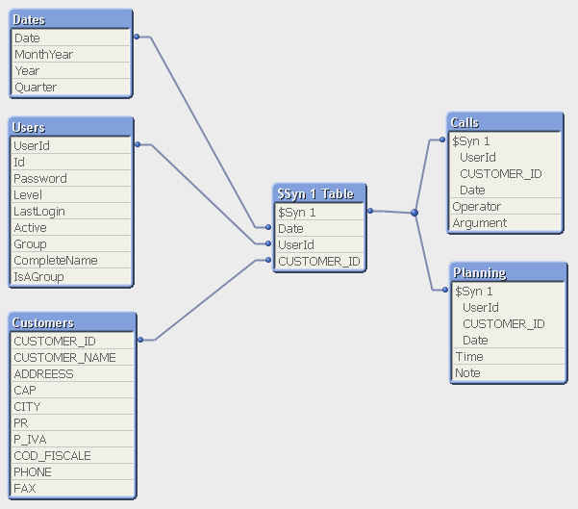
The Typical Question – A Possible Solution
This structure will load, as is, into QlikView cleanly, with no circular loops, and 1 synthetic key:

Slide 5
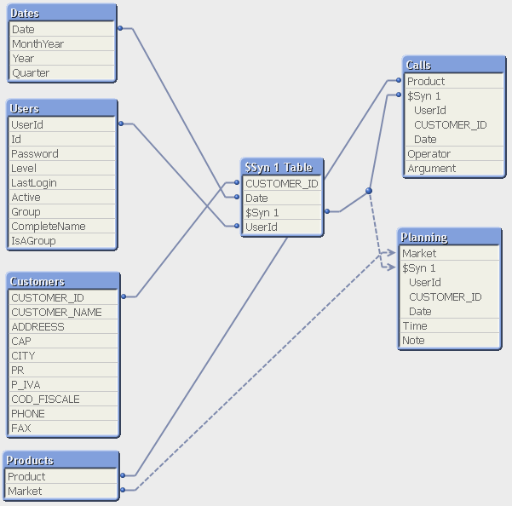
The Typical Question – Add Product/Market
However, if Product information is added, and Product is added to Calls, Market added to Planning:
The structure quickly degrades to a circular loop and a loosely coupled table

Slide 6
Problems with traditional Data Structures
Synthetic keys
Greater possibility of circular loops
Selection of one type of data precludes other types of data
Difficult to add new types of data, especially fact
Does not support Generic Keys cleanly
Relationships are typically complex and
hard to understand

Slide 7
Multiple Fact Table Structure
An alternative approach for the QlikView logical data structure in complex applications.
Multiple Fact Table Structures are designed to avoid the problems with traditional structures by creating a star schema in QlikView, separating data into Dimensions and a single Fact table. This is cleaner, easier, and more efficient than multiple Fact tables in a traditional link table structure.
Then, associating these two types of data with “linking” tables to obtain Generic Key benefits

Slide 8
Multiple Fact Data Structures Design Technique
Phil Bishop
Principal – Natural Synergies, Inc.
phil.bishop@naturalsynergies.com

Slide 9
Design Technique - Dimensions
Dimension tables contain relatively static component data, such as Products, Customers, Employees, and Dates.
All selectable fields (including chart dimensions) should reside in these tables (and optionally in a secondary link table).
These tables will almost always have a single key field. It is possible that some dimension tables will share the same key field.
Dimension tables can also include "counting“ tables, which contain the DISTINCT key field values and a constant (typically 1) used to sum the current number of selected values, e.g. sum(Physician_Count)
Note: It is generally good practice in QlikView to try to stay as close to the STAR schema as possible, and avoid normalizing (or snowflaking) dimension tables. This will result in the shortest possible chain lengths (traverses) when resolving a chart expression.

Slide 10
Design Technique – Dimensions Example
Example:
D_Territory:
Load
Territory as [%Territory],
Territory,
District,
Region
FROM [Sales Geography.csv] (ansi, txt, delimiter is ',', embedded labels);

Slide 11
Exercise 1
Open LinkTable85_Exercise.qvw
Review Dimension tab in load script

Slide 12
Design Technique - Fact
The Fact table contains transaction data. The data is almost always time-based, and each row is typically defined by combinations of dimension keys, e.g. Date, Product, Customer (Physician in this example).
The final load of the Fact Table data will contain all key fields. Use generic for key fields that do not exist in a particular fact table set of records.
Other fields will include measure fields, e.g. TRx (sales amount) that will be aggregated in charts and other UI objects. In addition, flag fields should be included here.
The Fact Table should NEVER contain selectable fields, since selection in one set of fact table records will cause almost all other fact table records to become non referenced (due to specific keys).

Slide 13
Design Technique – Fact Example
Example:
All_Facts:
Load
// KEYS
DateIndex as [%Date],
$(v_A) $(v_S) PhysicianID as [%Territory_Physician],
ProductID as [%Product],
$(v_A) as [%DetailPositionLink],
// FLAGS
-1*(right(ProductID,2)='01') as flag_TRx_Company,
-1*(DateIndex < 4) as flag_curr_3m,
-1*(DateIndex > 3 and DateIndex < 7) as flag_prev_3m,
applymap('M_Current_Year',DateIndex,0) as flag_curr_y,
// MEASURES
TRx
FROM Sales_Source.qvd (qvd)
WHERE
TRx <> 0;
Generic Key for sales territory
Define flags here to avoid double counting w/ generic keys
Should rarely, if ever need zero values

Slide 14
Exercise 2
Open LinkTable85_Exercise.qvw
Add additional Fact table records from Calls_Sample.qvd
- Use [Fact Table: Call Activity] sheet
- Concatenate to All_Facts table
- Define all standard key fields
- Define all standard flag fields
- Use 1 as Sample_Count
- Include SampleQuantity as a measure

Slide 15
Design Technique – Secondary Link Tables
Secondary Link tables are optional, but serve a number of purposes.
These tables define relationships between dimension and fact tables as well as between multiple dimension tables. For example, the relationship between territories and physicians will be defined in the secondary link table L2_Alignment. This feature allows a generic key that still honors the inherent data relationships and hierarchies.
This is where all generic keys are defined. A generic key is a specific value (typically 'ALL', set in variable [v_A]) that replaces the existing value in the portion of the field (or the field itself) that connects to the FACT table. The generic value should never exist in the key field link to the dimension table.
Selection fields are allowed in these tables, but are generally rare.
Recommendation is to use DISTINCT on all loads

Slide 16
Design Technique – Secondary Link Tables Example
This is link to Fact table. It should match Fact table keys.
Example:
L2_Detail_Position:
Load DISTINCT
[%DetailPosition] as [%DetailPositionLink],
[%DetailPosition]
Resident
D_Detail_Position;
// GENERIC DETAIL POSITION
CONCATENATE (L2_Detail_Position)
Load DISTINCT
$(v_A) as [%DetailPositionLink],
[%DetailPosition]
Resident
D_Detail_Position;
This is the Generic value.
This key links directly to the Dimension table. These types of keys should never be generic.

Slide 17
Generic Keys
Phil Bishop
Principal – Natural Synergies, Inc.
phil.bishop@naturalsynergies.com

Slide 18
Generic keys
The main purpose of generic keys is to allow the use of a standard set of Fact table keys without requiring key values for all dimensions and all types of fact data.
A generic key is a specific value (typically 'ALL', set in variable [v_A]) that replaces the existing value in the portion of the field (or the field itself) that connects to the Fact table.
Make sure that the value you use will never occur in your actual data.
The generic value should never exist in the key field link to the dimension table.

Slide 19
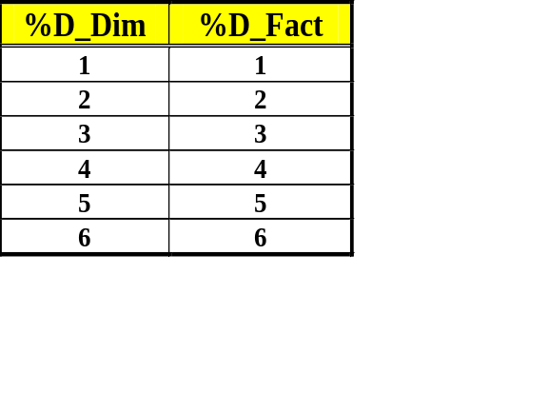
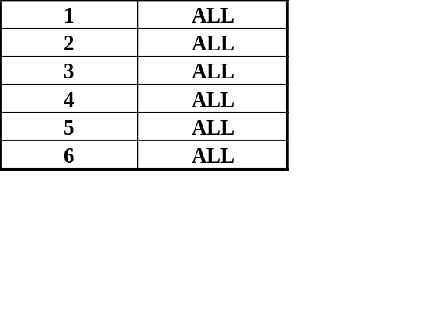
Generic keys - Single Key Field
To create a generic value for a single key, simply repeat each record with the generic value.

Slide 20
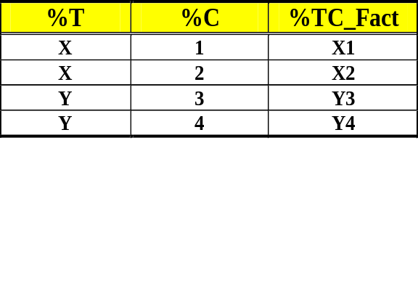
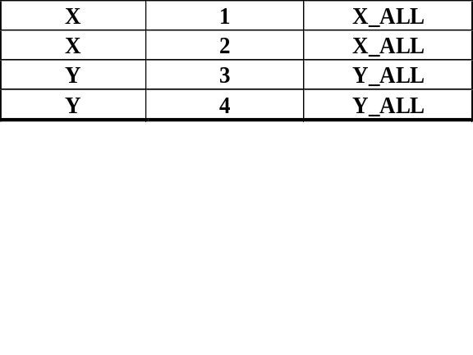
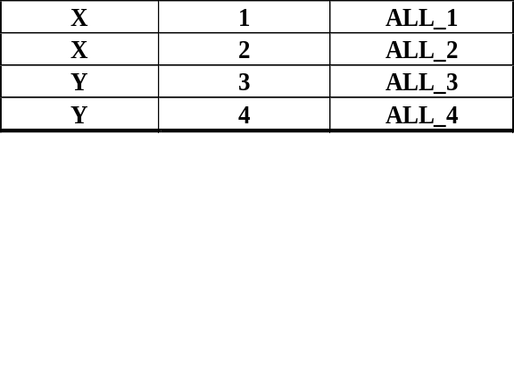
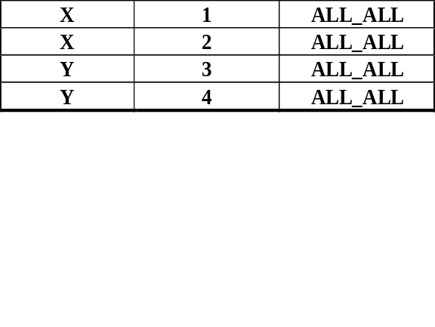
Generic keys - Multiple Key Fields
To create a generic value for multiple keys, reload data for all required combinations of generic data.

Slide 21
Exercise 3
Open LinkTable85_Exercise.qvw
Add load for generic Territory in table [L2_Alignment]
- Use [Secondary Link Tables] sheet
- Concatenate to L2_Alignment table
- Use defined variables for generic key and separator

Slide 22
Calculating Absolute Market Share
Using Set Analysis
Phil Bishop
Principal – Natural Synergies, Inc.
phil.bishop@naturalsynergies.com

Slide 23
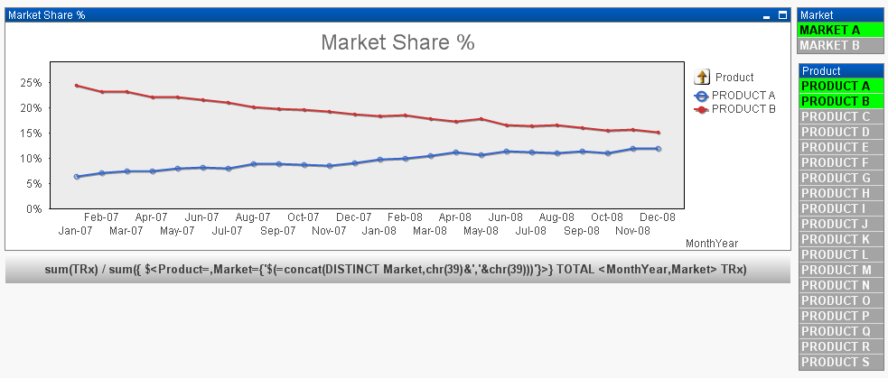
Set Analysis
With Set Analysis, we no longer need to pre-aggregate denominator values for market share. Use a Set that defines the current selection minus any product selection for the denominator. In this case, we should also add a select for the associated Market in order to get the correct result regardless of selection state.

Slide 24
Set Analysis
Calculating Market Share:
Market Share = Sum of Product Sales / Sum of all Products in Market Sales
In our example:
Sum of Product Sales = Sum (TRx)
Sum of all Products in Market Sales = Sum ({ $<Product=>} TRx)
Since the calculation is taking place within a chart, we need to account for the dimensions using TOTAL <MonthYear,Market>
{ $<Product=,Market={'$(=concat(DISTINCT Market,chr(39)&','&chr(39)))'}>}
Since it is possible that no Market is selected, we need to account for this
in the Set Analysis by “selecting” the possible markets. Use the
Concat() function to list the Market values associated with each
Product (value in the dimension)

Slide 25
Set Analysis
Set Analysis Observations:
Be careful of syntax
Avoid using key fields
Set Analysis seems to use chart cache a little different
Understand use of TOTAL when working within chart dimensions
Be careful of using Suppress When Value Is Null on chart dimensions

Slide 26
Exercise 4
Open LinkTable85_Exercise.qvw
Client would like to add Goal data to this document. This is a rolling comparison of 24 months of sales data used to compare to the 24 months of current data for Company products.
Goal data is located in Sales_Goal.qvd
Goal data has Product and Physician (Customer), but no time dimension.
Add a new tab in load script, and add Goal data to All_Facts
Add script code to account for generic dates
Add a bar chart comparing sum(TRx) to sum(TRx_Goal) by Product_Company

